Slide 1
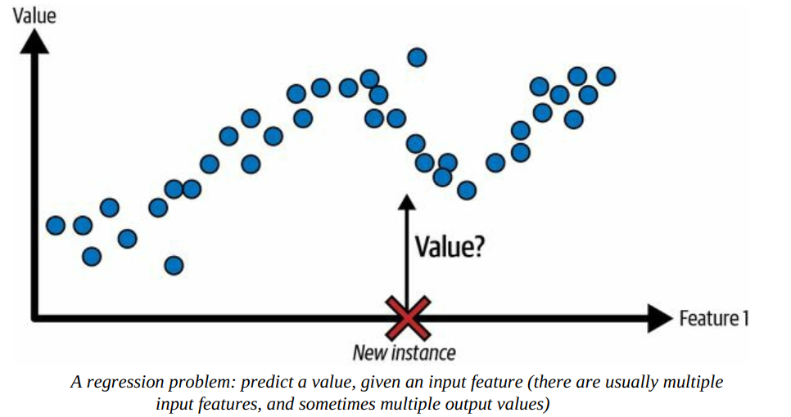
Supervised Learning: Regression
A typical task is to predict a target numeric value, such as the price of a car, given a set of features (mileage, age, brand, etc.). This sort of task is called regression.⁠

Slide 2
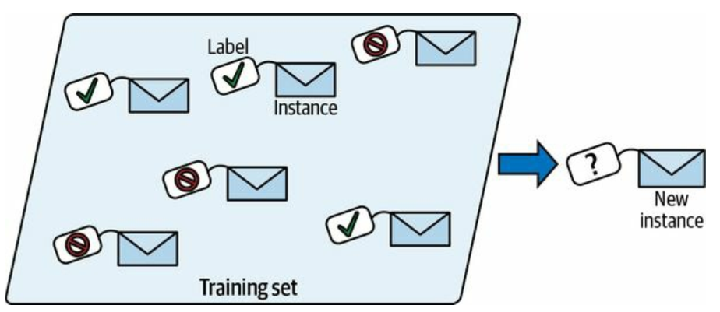
Supervised Learning
Another typical supervised learning task is classification. The spam filter is a good example of this: it is trained with many example emails along with their class (spam or ham), and it must learn how to classify new emails.

Slide 3
Regression
Simple Linear Regression
Multiple Linear Regression
Polynomial Linear Regression
Logistic Regression

Slide 4
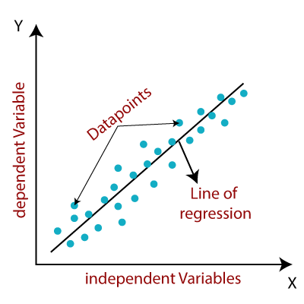
Linear Regression
Linear regression is a supervised machine learning algorithm that models the linear relationship between a dependent variable and one or more independent variables by fitting a straight line to the observed data.
https://www.javatpoint.com/linear-regression-in-machine-learning

Slide 5
Linear Regression
Linear regression is a supervised machine learning algorithm that models the linear relationship between a dependent variable and one or more independent variables by fitting a straight line to the observed data.
When there is a single independent variable, it is referred to as Simple Linear Regression, whereas with multiple independent variables, it is called Multiple Linear Regression.
Polynomial Linear Regression is a form of regression where the relationship between the independent variable(s) and the dependent variable is modeled as a polynomial, but it is still considered a type of linear regression because the model is linear in terms of the coefficients.

Slide 6
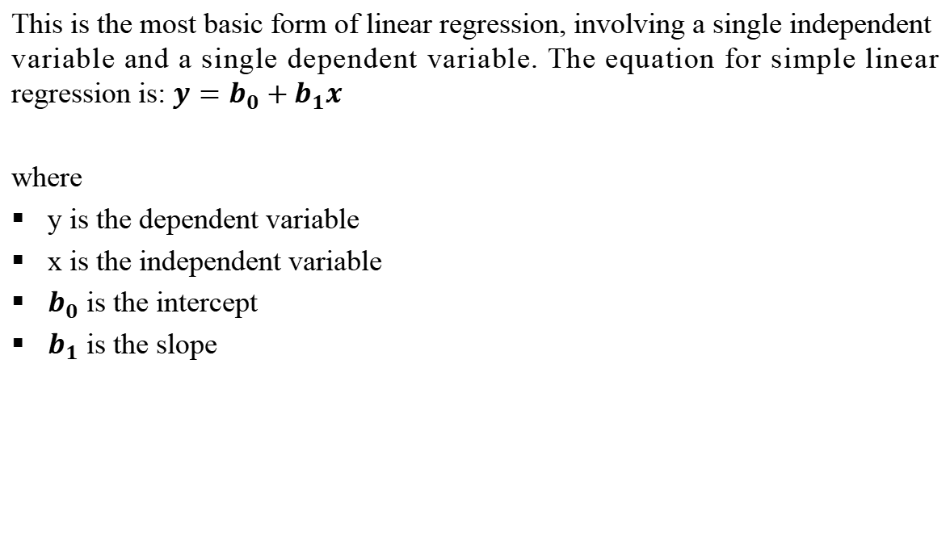
Simple Linear Regression
This is the most basic form of linear regression, involving a single independent variable and a single dependent variable. The equation for simple linear regression is: $y=b_{0}+b_{1}x$
where
y is the dependent variable
x is the independent variable
$b_{0}$ is the intercept
$b_{1}$ is the slope

Slide 7
Example
Suppose we are analyzing the relationship between the number of hours a student studies (x) and their exam score (y) using a simple linear regression. After running the regression, we get the following equation: y=5x+50
In this equation:
𝑦is the predicted exam score,
𝑥is the number of hours studied,
The slope 𝑚 = 5
m=5 indicates that for each additional hour of studying, the exam score is expected to increase by 5 points.
The intercept 𝑏= 50
b=50 suggests that if a student studies 0 hours, the predicted exam score would be 50 points.

Slide 8
Example calculation using the slope:
If a student studies 4 hours (𝑥= 4 ),
the predicted score is: y=5(4)+50=20+50=70
Thus, according to this regression model, studying for an extra hour would raise a student’s expected exam score by 5 points.

Slide 9
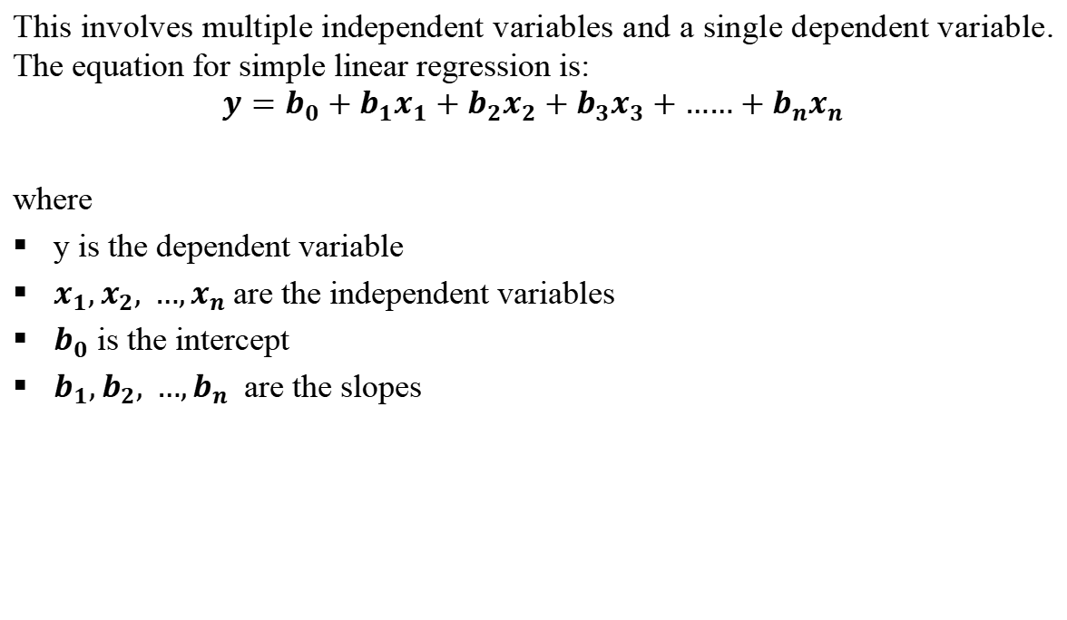
Multiple Linear Regression
This involves multiple independent variables and a single dependent variable. The equation for simple linear regression is:
$$y=b_{0}+b_{1}x_{1}+b_{2}x_{2}+b_{3}x_{3}+{……+b}_{n}x_{n}$$
where
y is the dependent variable
$x_{1},x_{2}, …,x_{n}$are the independent variables
$b_{0}$ is the intercept
$b_{1},b_{2}, …,b_{n}$ are the slopes

Slide 10
EXample
Scenario
Imagine we want to predict a person’s monthly salary (y) based on their years of education (x1) and years of work experience (x2). The multiple regression model would look like this:
y=b0+b1x1+b2x2
Where:
Y is the monthly salary (dependent variable),
X_{1​} is the number of years of education,
x₂ is the number of years of work experience,
b₀ is the intercept (baseline salary if x1 and x2 are zero),
b_{1​} and b₂ are the coefficients showing how much salary changes with each additional year of education and experience, respectively.

Slide 11
EXample
Example Model Output
Let’s say we use data to fit this model, and the result is:
y=2000+1500x₁+800x₂
Interpretation:
Intercept (2000): A baseline salary of $2,000 for someone with zero years of education and experience.
Coefficient for x₁ (1500): Each additional year of education increases the predicted salary by $1,500.
Coefficient for x₂ (800): Each additional year of work experience increases the predicted salary by $800.

Slide 12
EXample
Using the Model
If a person has 16 years of education and 5 years of work experience, we can predict their salary as follows:
y=2000+1500(16)+800(5)=2000+24000+4000=30,000
So, based on this model, their predicted monthly salary would be $30,000

Slide 13
Linear Regression
The objective of the algorithm is to determine the best-fit line equation that can predict values based on the independent variables.
In regression, a dataset with X and Y values is provided, and these values are used to train a function. Once trained, this function can be applied to predict Y for an unknown X.
In regression, the goal is to estimate the value of Y, meaning a function is needed that predicts the continuous Y value given X as the independent variable(s).

Slide 14
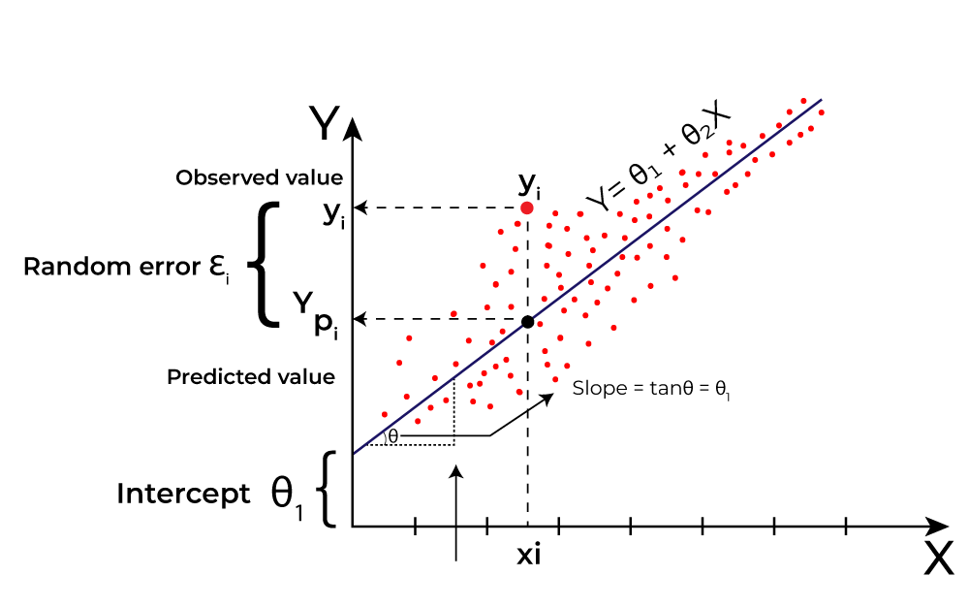
Linear Regression
What is the best Fit Line?
The main goal of using linear regression is to find the best-fit line, which minimizes the error between the predicted and actual values. The best-fit line will have the least amount of error.
The equation of the best-fit line represents the relationship between the dependent and independent variables, with the slope indicating how much the dependent variable changes in response to a unit change in the independent variable(s).
https://www.geeksforgeeks.org/ml-linear-regression/

Slide 15
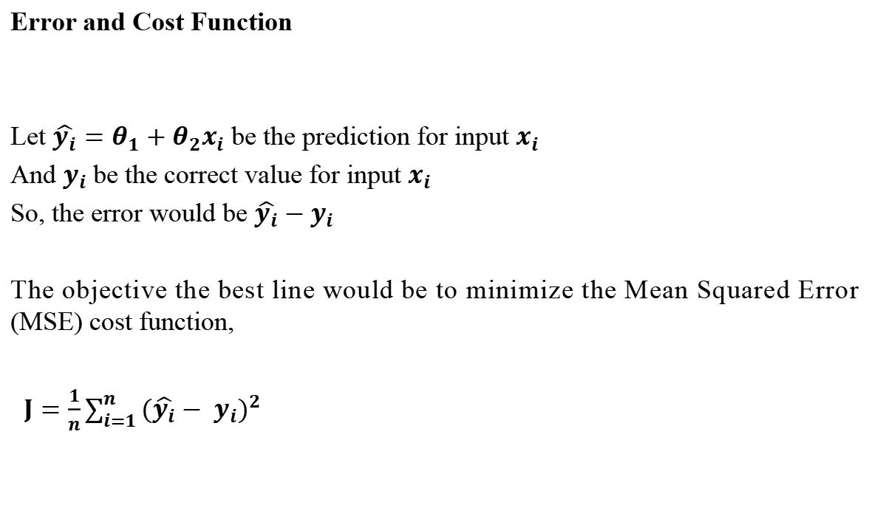
Linear Regression
Error and Cost Function
Let $\hat{y_{i}}=θ_{1}+θ_{2}x_{i}$ be the prediction for input $x_{i}$
And $y_{i}$be the correct value for input $x_{i}$
So, the error would be $\hat{y_{i}}−$ $y_{i}$
The objective the best line would be to minimize the Mean Squared Error (MSE) cost function,
$J=\frac{1}{n}\sum_{i=1}^{n}{{(\hat{y_{i}}− y_{i})}^{2}}$

Slide 16
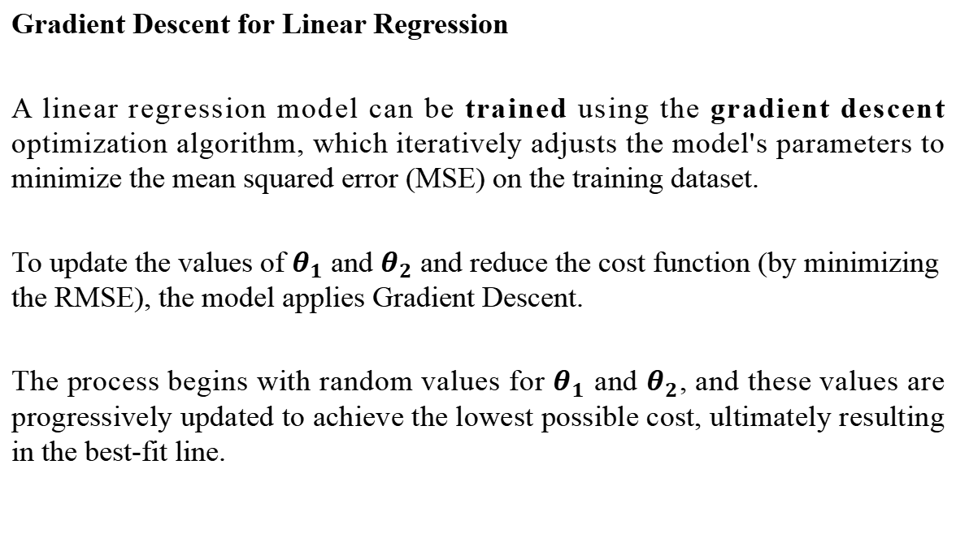
Linear Regression
Gradient Descent for Linear Regression
A linear regression model can be trained using the gradient descent optimization algorithm, which iteratively adjusts the model's parameters to minimize the mean squared error (MSE) on the training dataset.
To update the values of $θ_{1}$ and $θ_{2}$ and reduce the cost function (by minimizing the RMSE), the model applies Gradient Descent.
The process begins with random values for $θ_{1}$ and $θ_{2}$, and these values are progressively updated to achieve the lowest possible cost, ultimately resulting in the best-fit line.

Slide 17
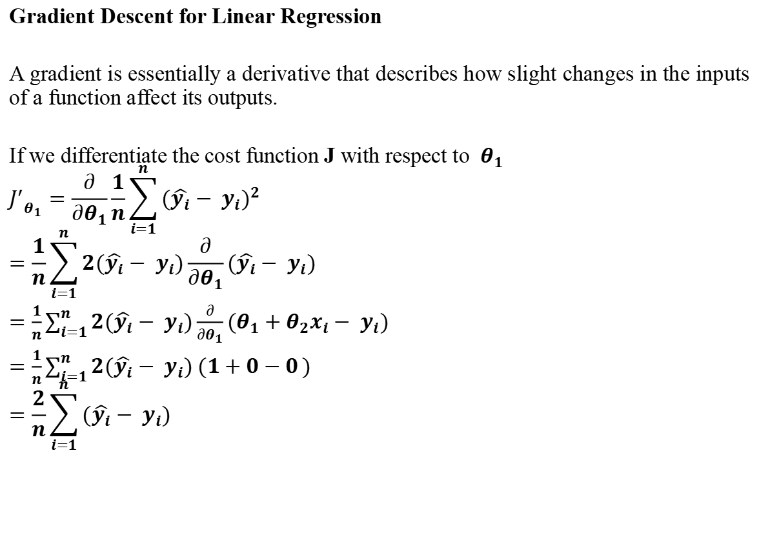
Linear Regression
Gradient Descent for Linear Regression
A gradient is essentially a derivative that describes how slight changes in the inputs of a function affect its outputs.
If we differentiate the cost function J with respect to ​ $θ_{1}$
$${J^{′}}_{θ_{1}}=\frac{∂}{∂θ_{1}}\frac{1}{n}\sum_{i=1}^{n}{{(\hat{y_{i}}− y_{i})}^{2}}$$
$$=\frac{1}{n}\sum_{i=1}^{n}{2(\hat{y_{i}}− y_{i})}\frac{∂}{∂θ_{1}}(\hat{y_{i}}− y_{i})$$
$=\frac{1}{n}\sum_{i=1}^{n}{{2(\hat{y_{i}}− y_{i})\frac{∂}{∂θ_{1}}(θ}_{1}+θ_{2}x_{i}− y_{i})}$
$=\frac{1}{n}\sum_{i=1}^{n}{2(\hat{y_{i}}− y_{i}) (1+0−0})$
$$=\frac{2}{n}\sum_{i=1}^{n}{(\hat{y_{i}}− y_{i})}$$

Slide 18
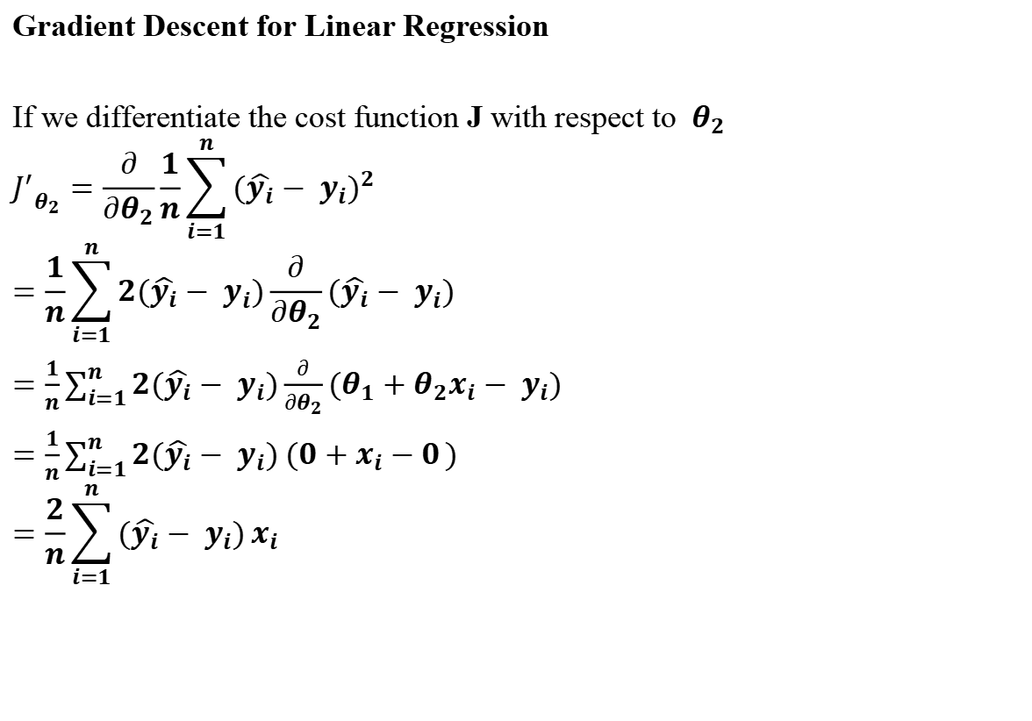
Linear Regression
Gradient Descent for Linear Regression
If we differentiate the cost function J with respect to ​ $θ_{2}$
$${J^{′}}_{θ_{2}}=\frac{∂}{∂θ_{2}}\frac{1}{n}\sum_{i=1}^{n}{{(\hat{y_{i}}− y_{i})}^{2}}$$
$$=\frac{1}{n}\sum_{i=1}^{n}{2(\hat{y_{i}}− y_{i})}\frac{∂}{∂θ_{2}}(\hat{y_{i}}− y_{i})$$
$=\frac{1}{n}\sum_{i=1}^{n}{{2(\hat{y_{i}}− y_{i})\frac{∂}{∂θ_{2}}(θ}_{1}+θ_{2}x_{i}− y_{i})}$
$=\frac{1}{n}\sum_{i=1}^{n}{2(\hat{y_{i}}− y_{i}) (0+x_{i}−0})$
$$=\frac{2}{n}\sum_{i=1}^{n}{(\hat{y_{i}}− y_{i})}x_{i}$$

Slide 19
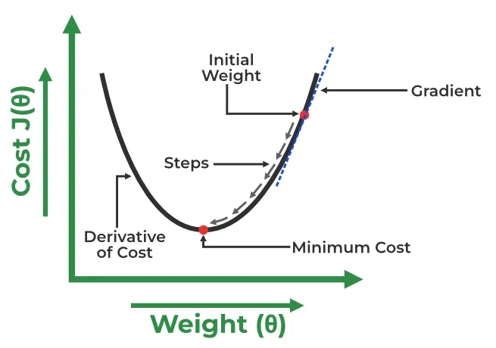
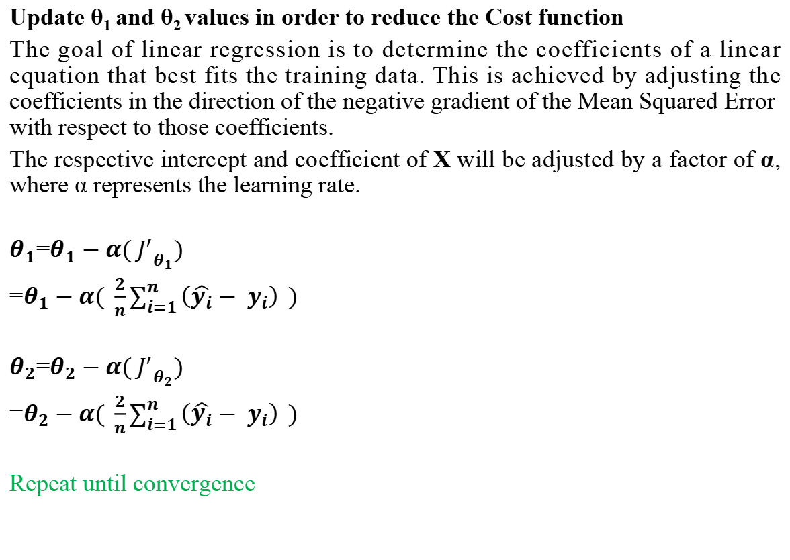
Linear Regression
Update θ₁ and θ₂ values in order to reduce the Cost function
The goal of linear regression is to determine the coefficients of a linear equation that best fits the training data. This is achieved by adjusting the coefficients in the direction of the negative gradient of the Mean Squared Error with respect to those coefficients.
The respective intercept and coefficient of X will be adjusted by a factor of α, where α represents the learning rate.
$θ_{1}$=$θ_{1}−α( {J^{′}}_{θ_{1}})$
=$θ_{1}−α( \frac{2}{n}\sum_{i=1}^{n}{\left(\hat{y_{i}}− y_{i}\right)} )$
$θ_{2}$=$θ_{2}−α( {J^{′}}_{θ_{2}})$
=$θ_{2}−α( \frac{2}{n}\sum_{i=1}^{n}{\left(\hat{y_{i}}− y_{i}\right)} )$
Repeat until convergence
https://www.geeksforgeeks.org/ml-linear-regression/

Slide 20
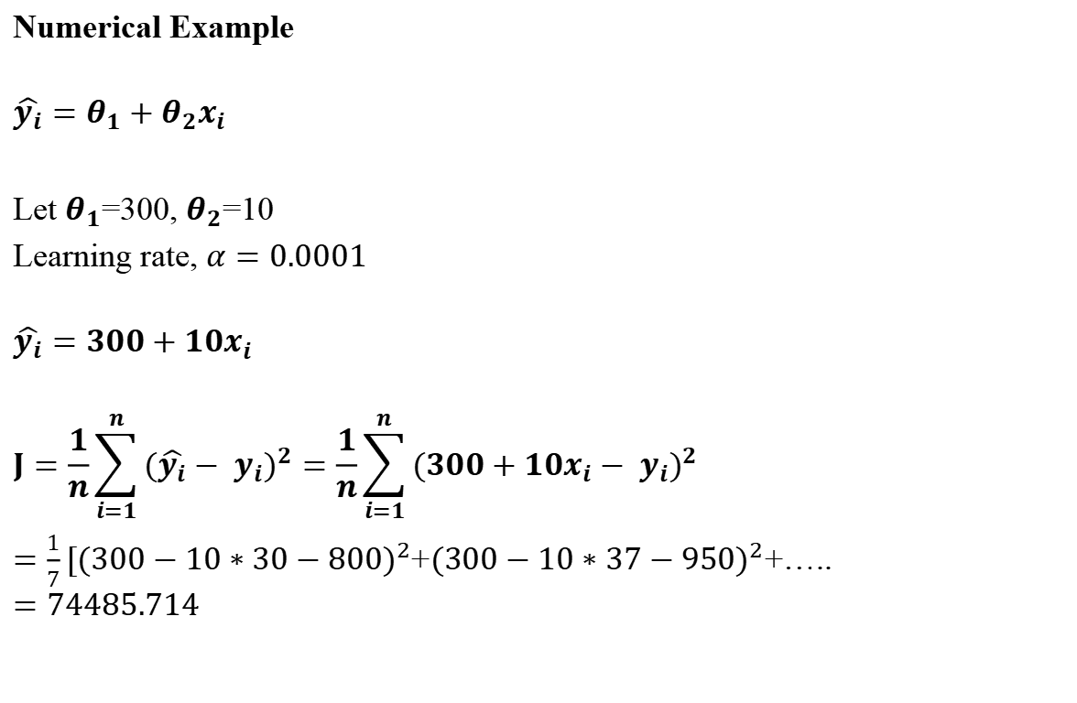
Linear Regression
Age (x) | Salary (y)
30 | 800
37 | 950
25 | 600
43 | 1050
50 | 1200
29 | 740
46 | 1100
Numerical Example
$$\hat{y_{i}}=θ_{1}+θ_{2}x_{i}$$
Let $θ_{1}$=300, $θ_{2}$=10
Learning rate, $α=0.0001$
$$\hat{y_{i}}=300+10x_{i}$$
$$J=\frac{1}{n}\sum_{i=1}^{n}{{(\hat{y_{i}}− y_{i})}^{2}}=\frac{1}{n}\sum_{i=1}^{n}{{(300+10x_{i}− y_{i})}^{2}}$$
$=\frac{1}{7}[{(300−10∗30−800)}^{2}$+${(300−10∗37−950)}^{2}$+…..
$$=74485.714$$

Slide 21
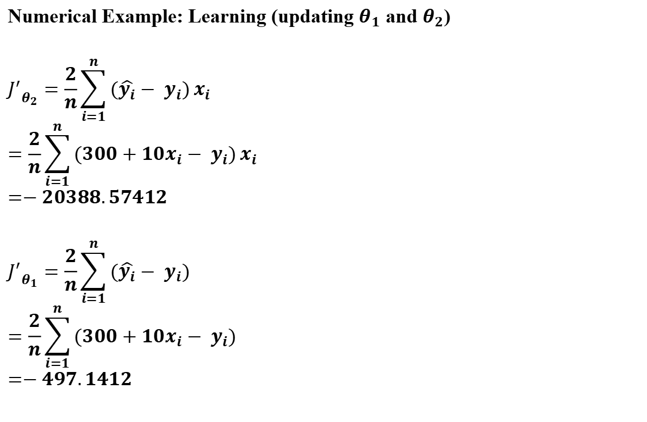
Linear Regression
Age (x) | Salary (y)
30 | 800
37 | 950
25 | 600
43 | 1050
50 | 1200
29 | 740
46 | 1100
Numerical Example: Learning (updating $θ_{1}$ and $θ_{2}$)
$${J^{′}}_{θ_{2}}=\frac{2}{n}\sum_{i=1}^{n}{(\hat{y_{i}}− y_{i})}x_{i}$$
$$=\frac{2}{n}\sum_{i=1}^{n}{(300+10x_{i}− y_{i})}x_{i}$$
$$=−20388.57412$$
$${J^{′}}_{θ_{1}}=\frac{2}{n}\sum_{i=1}^{n}{(\hat{y_{i}}− y_{i})}$$
$$=\frac{2}{n}\sum_{i=1}^{n}{(300+10x_{i}− y_{i})}$$
$$=−497.1412$$

Slide 22
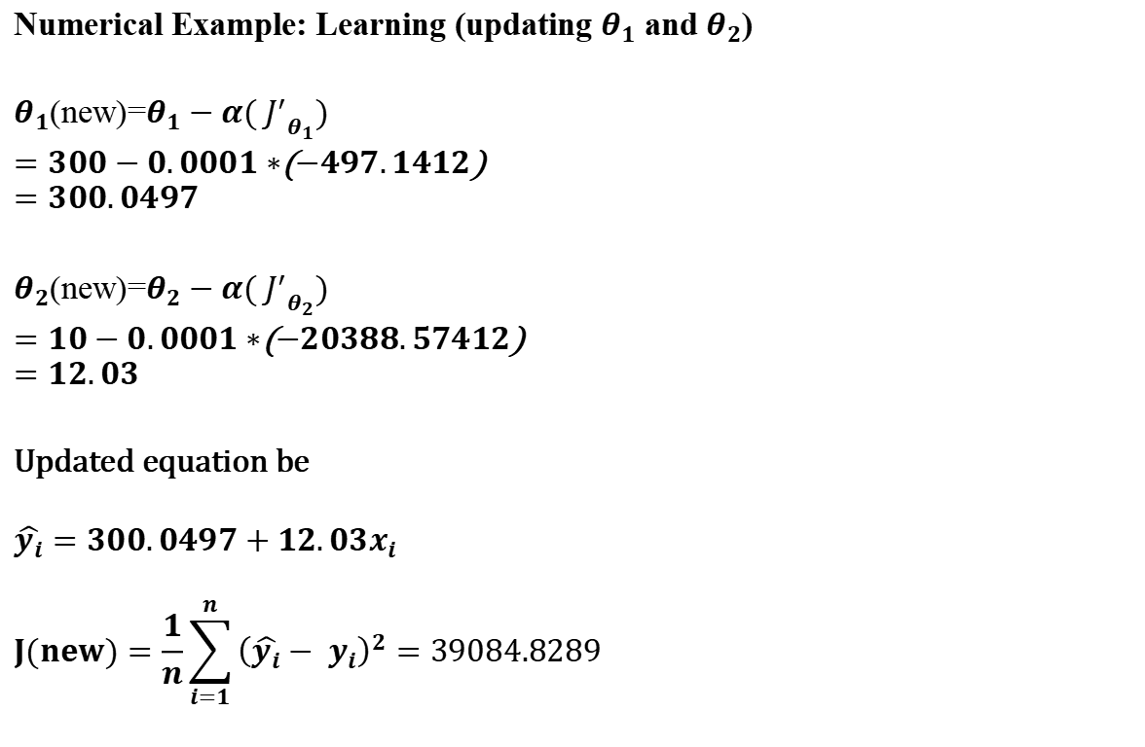
Linear Regression
Age (x) | Salary (y)
30 | 800
37 | 950
25 | 600
43 | 1050
50 | 1200
29 | 740
46 | 1100
Numerical Example: Learning (updating $θ_{1}$ and $θ_{2}$)
$θ_{1}$(new)=$θ_{1}−α( {J^{′}}_{θ_{1}})$
$=300−0.0001∗$($−497.1412$)
$$=300.0497$$
$θ_{2}$(new)=$θ_{2}−α( {J^{′}}_{θ_{2}})$
$=10−0.0001∗$($−20388.57412$)
$$=12.03$$
Updated equation be
$$\hat{y_{i}}=300.0497+12.03x_{i}$$
$$J(new)=\frac{1}{n}\sum_{i=1}^{n}{{\left(\hat{y_{i}}− y_{i}\right)}^{2}}=39084.8289$$
Repeat until convergence

Slide 23
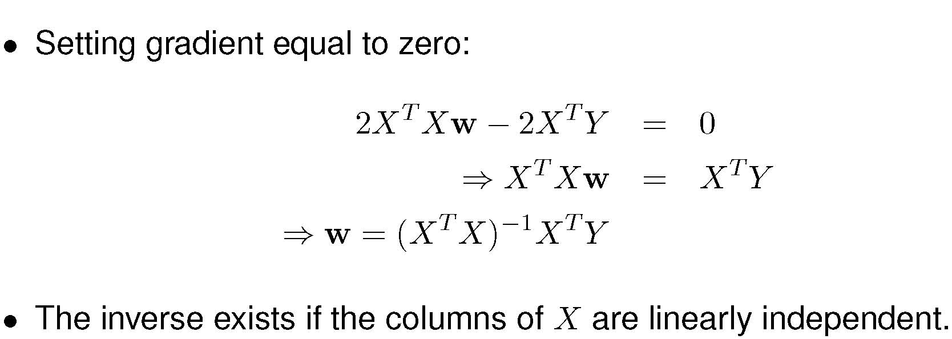
Some Linear Algebra - The Solution!
Notes:
1. The process in the previous slide can be performed as a matrix operation at once.

Slide 24
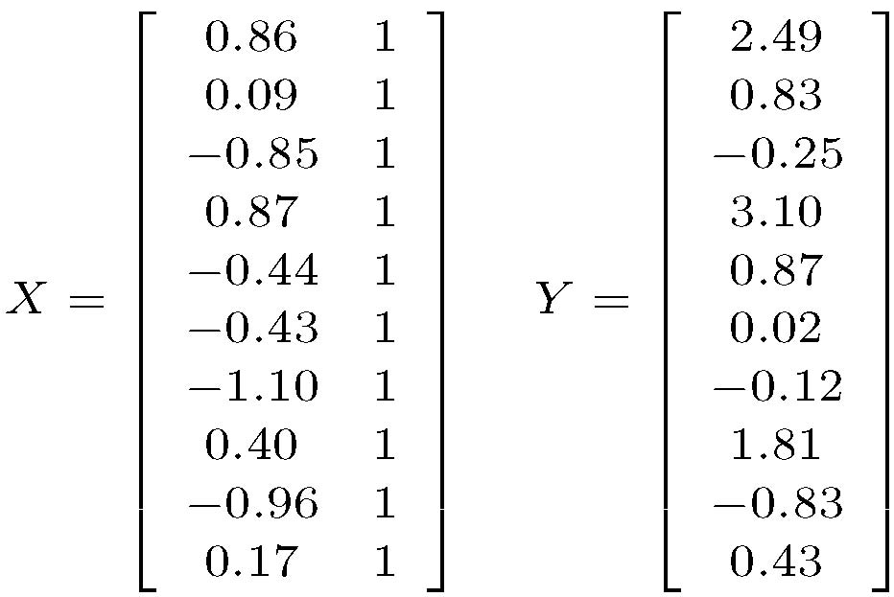
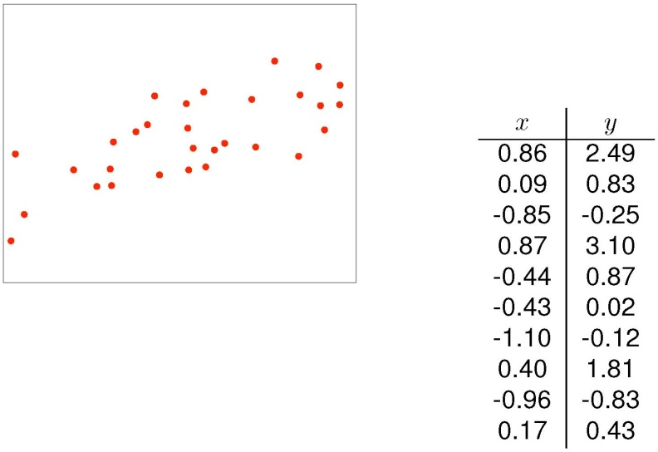
Example of Linear Regression - Data Matrices
Notes:
1. The process in the previous slide can be performed as a matrix operation at once.

Slide 25
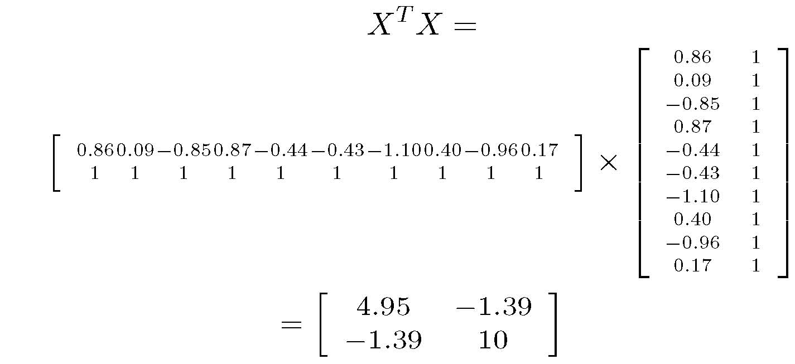
X^{T}X
Notes:
1. The process in the previous slide can be performed as a matrix operation at once.

Slide 26
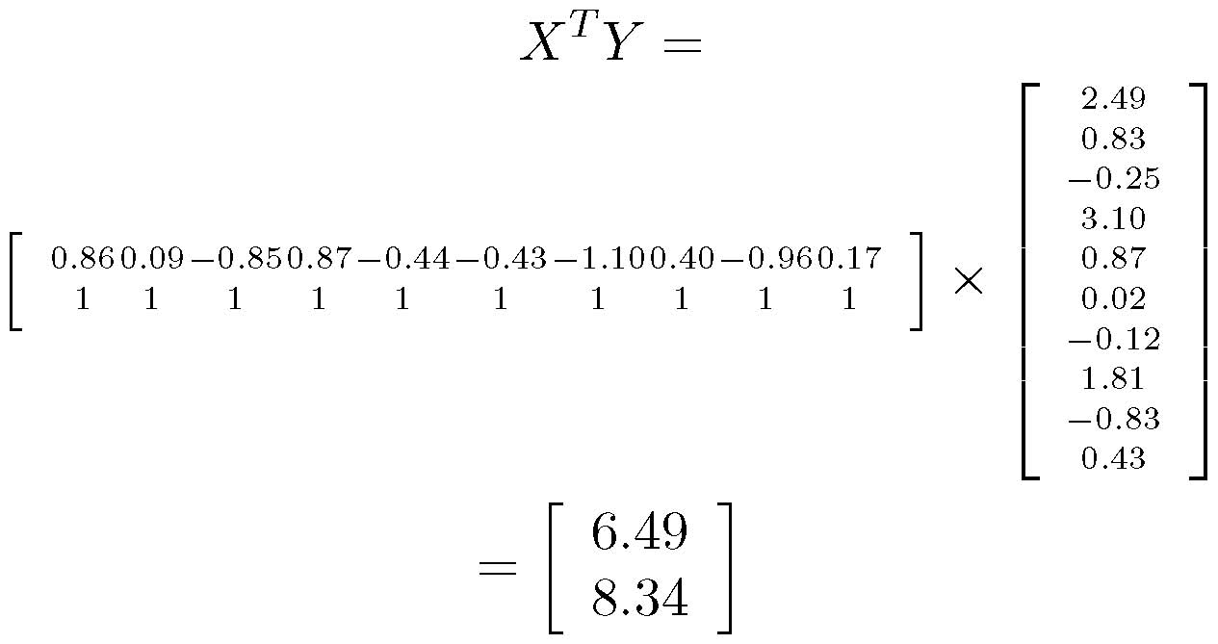
X^{T}Y
Notes:
1. The process in the previous slide can be performed as a matrix operation at once.

Slide 27
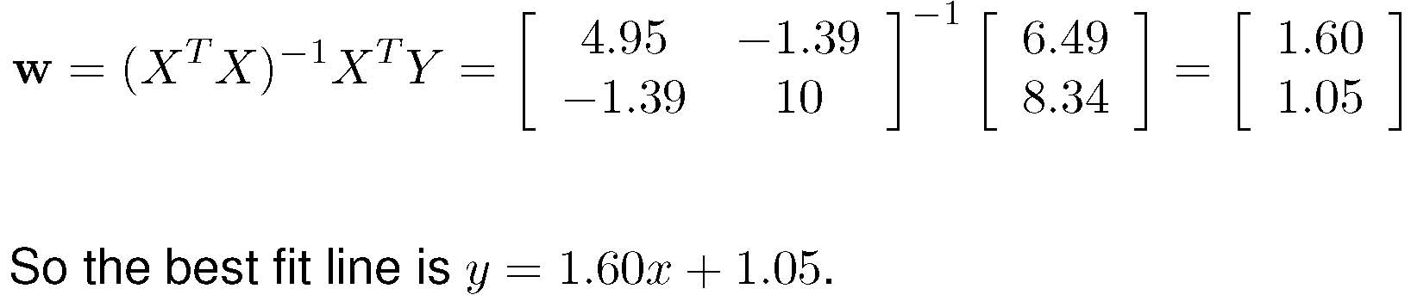
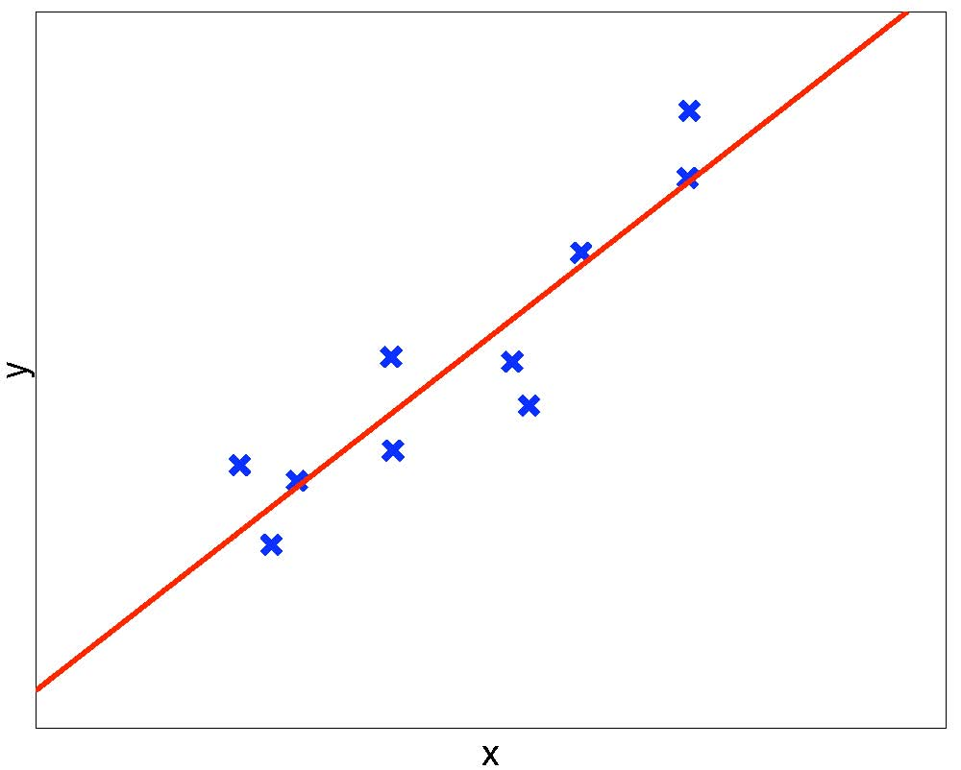
Solving for w – Regression Curve
Notes:
1. The process in the previous slide can be performed as a matrix operation at once.

Slide 28
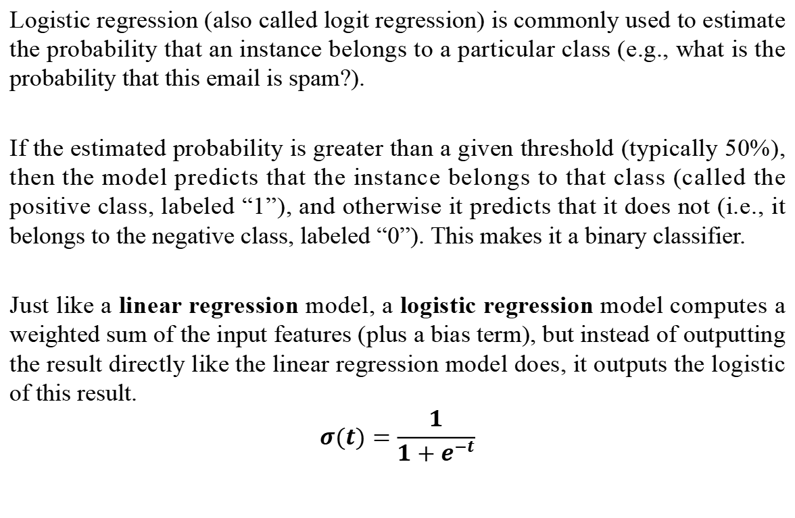
Logistic Regression
Logistic regression (also called logit regression) is commonly used to estimate the probability that an instance belongs to a particular class (e.g., what is the probability that this email is spam?).
If the estimated probability is greater than a given threshold (typically 50%), then the model predicts that the instance belongs to that class (called the positive class, labeled “1”), and otherwise it predicts that it does not (i.e., it belongs to the negative class, labeled “0”). This makes it a binary classifier.
Just like a linear regression model, a logistic regression model computes a weighted sum of the input features (plus a bias term), but instead of outputting the result directly like the linear regression model does, it outputs the logistic of this result.
$$σ(t)=\frac{1}{1+e^{−t}}$$

Slide 29
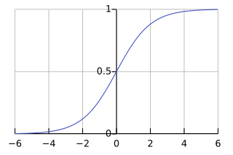
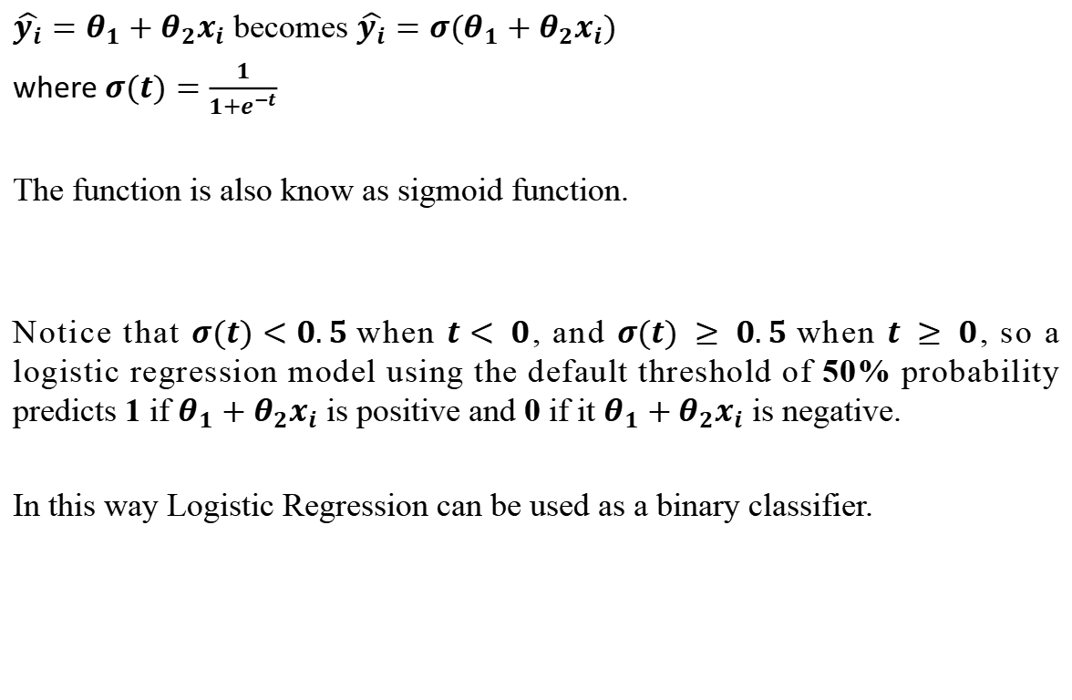
Logistic Regression
$\hat{y_{i}}=θ_{1}+θ_{2}x_{i}$ becomes $\hat{y_{i}}={σ(θ}_{1}+θ_{2}x_{i})$
where $σ(t)=\frac{1}{1+e^{−t}}$
The function is also know as sigmoid function.
Notice that $σ(t)<0.5$when $t< 0$, and $σ(t) ≥ 0.5$when $t ≥ 0$, so a logistic regression model using the default threshold of 50% probability predicts 1 if $θ_{1}+θ_{2}x_{i}$ is positive and 0 if it $θ_{1}+θ_{2}x_{i}$ is negative.
In this way Logistic Regression can be used as a binary classifier.
https://en.wikipedia.org/wiki/Sigmoid_function

Slide 30
Linear Regression Analysis – Application Scenarios (Best)
Target Application: Real Estate Pricing & Marketing ROI Forecasting Linear regression thrives in environments where variables possess a fundamentally additive and proportional relationship. It provides unmatched transparency for business stakeholders who need to understand the exact financial weight of individual metrics.
Core Justifications:
High Interpretability: The model produces distinct coefficients for each independent variable. A real estate firm can explicitly state that adding one square meter increases a property's value by $500, holding all else constant.
Low Computational Overhead: Matrix operations (like the Normal Equation) allow for near-instantaneous model updates when new data is ingested, without requiring prolonged training epochs.
Baseline Stability: It serves as a highly stable, deterministic benchmark to validate whether deploying a more complex, expensive model is actually worth the investment.
https://en.wikipedia.org/wiki/Sigmoid_function

Slide 31
Logistic Regression Analysis – Application Scenarios (Best)
Target Application: Credit Card Fraud Detection & Medical Diagnostics Logistic regression is the industry standard for binary classification tasks where understanding the calibrated probability of an outcome is just as critical as the final Yes/No decision.
Core Justifications:
Probabilistic Confidence: The Sigmoid function naturally bounds outputs between 0 and 1. Predicting that a transaction is 92% likely to be fraudulent allows a bank to automatically freeze an account, whereas a 65% probability might just trigger an SMS verification.
Ultra-Low Latency: Computing a linear combination and passing it through a Sigmoid function takes microseconds, making it perfect for screening thousands of global transactions per second.
Additional Examples:
Email Spam Filtering (Classifying incoming mail as Spam vs. Not Spam based on keyword frequencies).
Customer Conversion Prediction (Will a website visitor click the "Buy" button?).
https://en.wikipedia.org/wiki/Sigmoid_function

Slide 32
Linear Regression Analysis – Application Scenarios (Worst)
Target Application: Stock Market Prediction & Epidemiological Forecasting Linear regression assumes a straight-line relationship and constant variance (homoscedasticity). It completely fails in chaotic, volatile, or exponentially compounding systems.
Core Justifications:
Inability to Capture Non-Linearity: Standard linear regression cannot mathematically model sudden macroeconomic shocks, market crashes, or periods of exponential growth.
Assumption of Independence: Linear regression assumes each data point is independent. It ignores the sequential, time-dependent nature of financial or health data (where today's value heavily depends on yesterday's value).
Dangerous Extrapolation: Projecting a linear trend indefinitely into the future for a stock price will inevitably lead to drastically inaccurate, financially ruinous predictions.
Additional Examples:
Predicting the peak infection rate of a viral outbreak (which follows an S-curve, not a straight line).
Forecasting cryptocurrency prices based on social media sentiment over time.
https://en.wikipedia.org/wiki/Sigmoid_function

Slide 33
Logistic Regression Analysis – Application Scenarios (Worst)
Target Application: Computer Vision (Image Recognition) & Complex NLP Logistic regression struggles heavily when the target depends on complex, non-linear interactions between thousands or millions of raw, un-engineered features.
Core Justifications:
No Spatial Awareness: Logistic regression treats every pixel in an image as an isolated, independent feature. It completely ignores the spatial structure and proximity of pixels that actually form shapes and edges.
Inability to Learn Hierarchies: The model cannot build composite features natively (e.g., combining pixels to find a line, combining lines to find a square).
Feature Engineering Bottleneck: Achieving good performance on complex data requires humans to manually engineer non-linear features (like polynomial expansions), which is impossible for million-pixel images.
https://en.wikipedia.org/wiki/Sigmoid_function

Slide 34
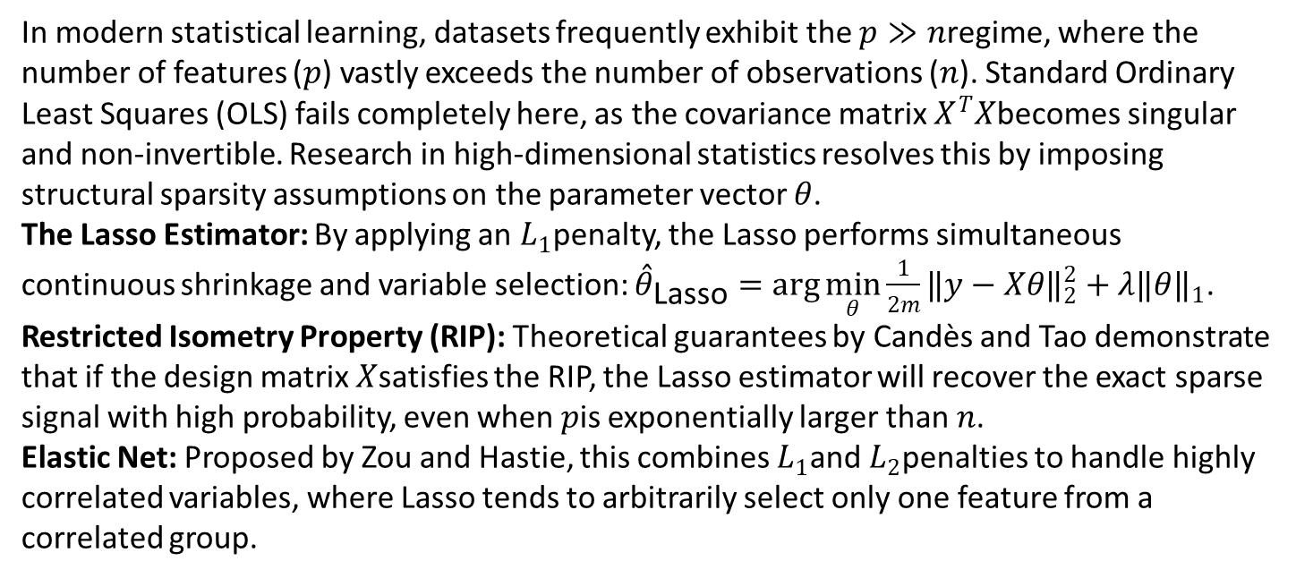
High-Dimensional Regression & Sparsity Guarantees
In modern statistical learning, datasets frequently exhibit the $p≫n$regime, where the number of features ($p$) vastly exceeds the number of observations ($n$). Standard Ordinary Least Squares (OLS) fails completely here, as the covariance matrix $X^{T}X$becomes singular and non-invertible. Research in high-dimensional statistics resolves this by imposing structural sparsity assumptions on the parameter vector $θ$.
The Lasso Estimator: By applying an $L_{1}$penalty, the Lasso performs simultaneous continuous shrinkage and variable selection: ${\overset{ˆ}{θ}}_{\text{Lasso}}=\arg{\min_{θ}{\frac{1}{2m}}}‖y−Xθ‖​_{2}^{2}+λ‖θ‖​_{1}$.
Restricted Isometry Property (RIP): Theoretical guarantees by Candès and Tao demonstrate that if the design matrix $X$satisfies the RIP, the Lasso estimator will recover the exact sparse signal with high probability, even when $p$is exponentially larger than $n$.
Elastic Net: Proposed by Zou and Hastie, this combines $L_{1}$and $L_{2}$penalties to handle highly correlated variables, where Lasso tends to arbitrarily select only one feature from a correlated group.
https://en.wikipedia.org/wiki/Sigmoid_function

Slide 35
Logistic Regression Analysis – Application Scenarios (Worst)
Target Application: Computer Vision (Image Recognition) & Complex NLP Logistic regression struggles heavily when the target depends on complex, non-linear interactions between thousands or millions of raw, un-engineered features.
Core Justifications:
No Spatial Awareness: Logistic regression treats every pixel in an image as an isolated, independent feature. It completely ignores the spatial structure and proximity of pixels that actually form shapes and edges.
Inability to Learn Hierarchies: The model cannot build composite features natively (e.g., combining pixels to find a line, combining lines to find a square).
Feature Engineering Bottleneck: Achieving good performance on complex data requires humans to manually engineer non-linear features (like polynomial expansions), which is impossible for million-pixel images.
https://en.wikipedia.org/wiki/Sigmoid_function

Slide 36
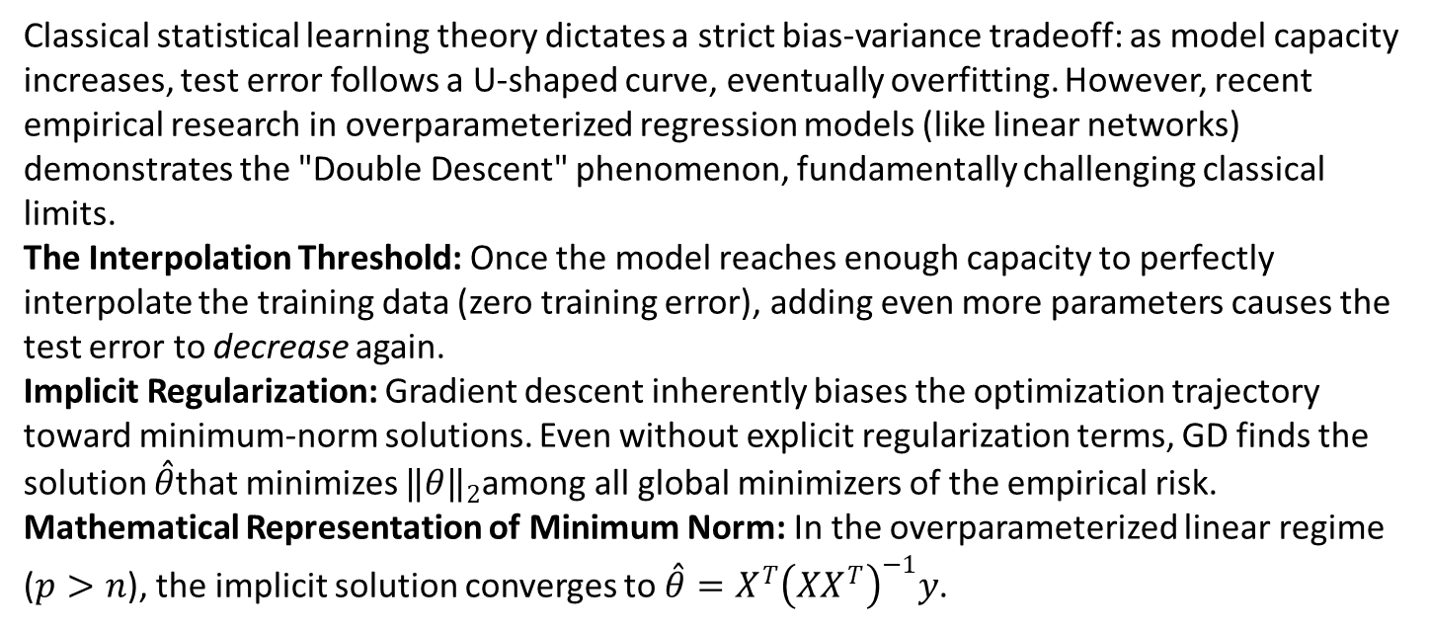
Non-Convex Optimization & The Double Descent Phenomenon
Classical statistical learning theory dictates a strict bias-variance tradeoff: as model capacity increases, test error follows a U-shaped curve, eventually overfitting. However, recent empirical research in overparameterized regression models (like linear networks) demonstrates the "Double Descent" phenomenon, fundamentally challenging classical limits.
The Interpolation Threshold: Once the model reaches enough capacity to perfectly interpolate the training data (zero training error), adding even more parameters causes the test error to decrease again.
Implicit Regularization: Gradient descent inherently biases the optimization trajectory toward minimum-norm solutions. Even without explicit regularization terms, GD finds the solution $\overset{ˆ}{θ}$that minimizes $‖θ‖​_{2}$among all global minimizers of the empirical risk.
Mathematical Representation of Minimum Norm: In the overparameterized linear regime ($p>n$), the implicit solution converges to $\overset{ˆ}{θ}=X^{T}{\left(XX^{T}\right)}^{−1}y$.
https://en.wikipedia.org/wiki/Sigmoid_function

Slide 37
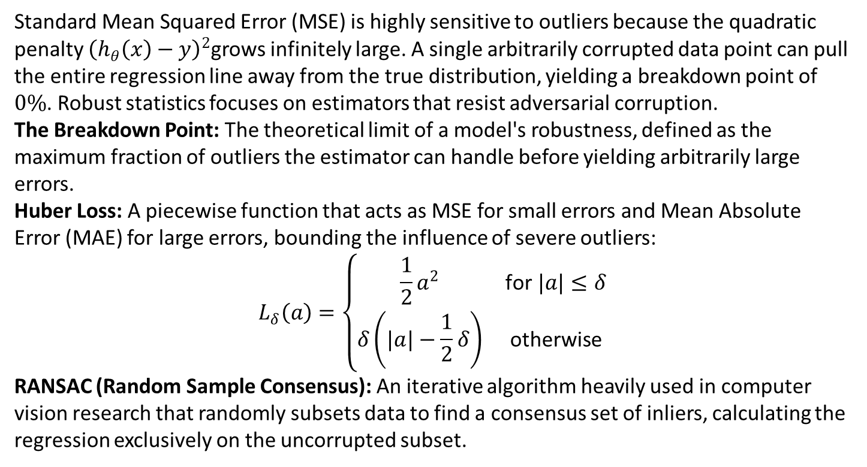
Robust Regression & Outlier Resistance
Standard Mean Squared Error (MSE) is highly sensitive to outliers because the quadratic penalty ${\left(h_{θ}\left(x\right)−y\right)}^{2}$grows infinitely large. A single arbitrarily corrupted data point can pull the entire regression line away from the true distribution, yielding a breakdown point of $0\%$. Robust statistics focuses on estimators that resist adversarial corruption.
The Breakdown Point: The theoretical limit of a model's robustness, defined as the maximum fraction of outliers the estimator can handle before yielding arbitrarily large errors.
Huber Loss: A piecewise function that acts as MSE for small errors and Mean Absolute Error (MAE) for large errors, bounding the influence of severe outliers:
$$L_{δ}\left(a\right)=\left\{\begin{matrix}\frac{1}{2}a^{2} & \text{for }|a|≤δ \\ δ\left(|a|−\frac{1}{2}δ\right) & \text{otherwise}\end{matrix}\right.$$
RANSAC (Random Sample Consensus): An iterative algorithm heavily used in computer vision research that randomly subsets data to find a consensus set of inliers, calculating the regression exclusively on the uncorrupted subset.
https://en.wikipedia.org/wiki/Sigmoid_function

Slide 38
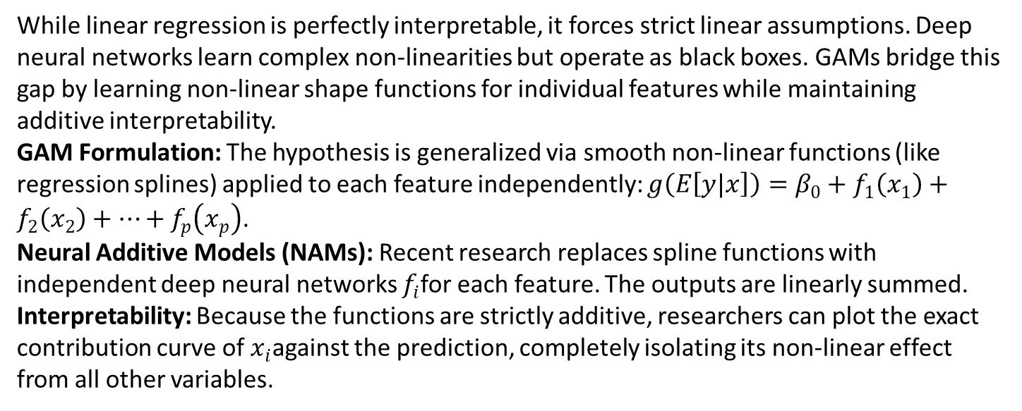
Generalized Additive Models (GAMs) & Neural Additive Models (NAMs)
While linear regression is perfectly interpretable, it forces strict linear assumptions. Deep neural networks learn complex non-linearities but operate as black boxes. GAMs bridge this gap by learning non-linear shape functions for individual features while maintaining additive interpretability.
GAM Formulation: The hypothesis is generalized via smooth non-linear functions (like regression splines) applied to each feature independently: $g\left(E\left[y|x\right]\right)=β_{0}+f_{1}\left(x_{1}\right)+f_{2}\left(x_{2}\right)+…+f_{p}\left(x_{p}\right)$.
Neural Additive Models (NAMs): Recent research replaces spline functions with independent deep neural networks $f_{i}$for each feature. The outputs are linearly summed.
Interpretability: Because the functions are strictly additive, researchers can plot the exact contribution curve of $x_{i}$against the prediction, completely isolating its non-linear effect from all other variables.
https://en.wikipedia.org/wiki/Sigmoid_function

Slide 39
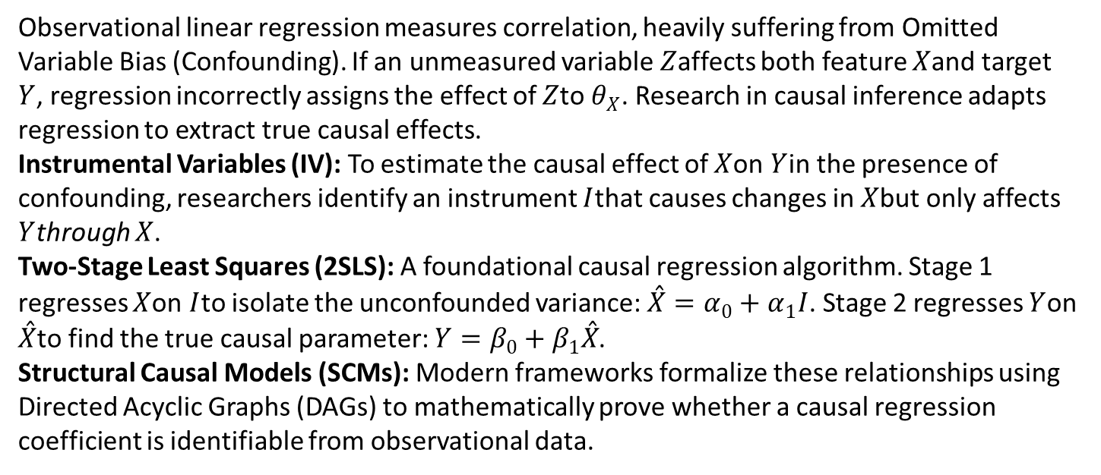
Causal Inference & Instrumental Variables in Regression
Observational linear regression measures correlation, heavily suffering from Omitted Variable Bias (Confounding). If an unmeasured variable $Z$affects both feature $X$and target $Y$, regression incorrectly assigns the effect of $Z$to $θ_{X}$. Research in causal inference adapts regression to extract true causal effects.
Instrumental Variables (IV): To estimate the causal effect of $X$on $Y$in the presence of confounding, researchers identify an instrument $I$that causes changes in $X$but only affects $Y$through $X$.
Two-Stage Least Squares (2SLS): A foundational causal regression algorithm. Stage 1 regresses $X$on $I$to isolate the unconfounded variance: $\overset{ˆ}{X}=α_{0}+α_{1}I$. Stage 2 regresses $Y$on $\overset{ˆ}{X}$to find the true causal parameter: $Y=β_{0}+β_{1}\overset{ˆ}{X}$.
Structural Causal Models (SCMs): Modern frameworks formalize these relationships using Directed Acyclic Graphs (DAGs) to mathematically prove whether a causal regression coefficient is identifiable from observational data.
https://en.wikipedia.org/wiki/Sigmoid_function

Slide 40
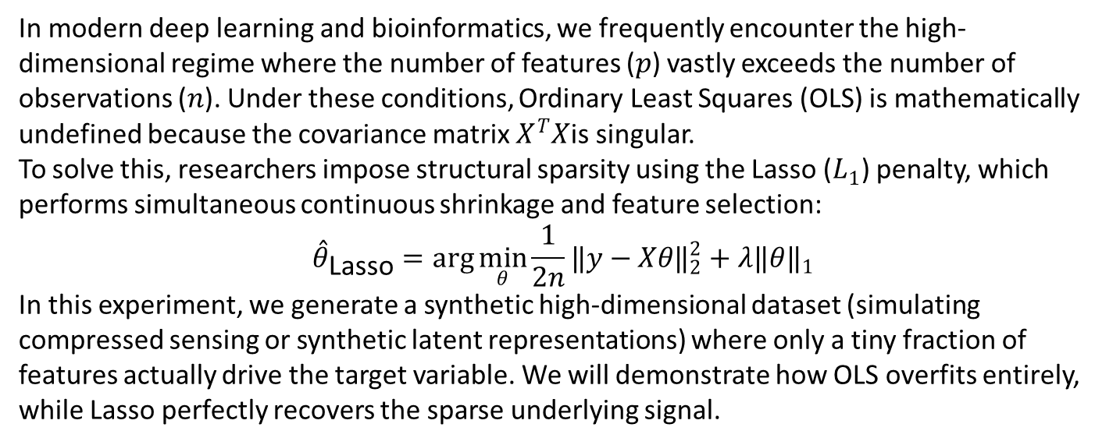
Research Frontier: High-Dimensional Regression ($p>n$)
In modern deep learning and bioinformatics, we frequently encounter the high-dimensional regime where the number of features ($p$) vastly exceeds the number of observations ($n$). Under these conditions, Ordinary Least Squares (OLS) is mathematically undefined because the covariance matrix $X^{T}X$is singular.
To solve this, researchers impose structural sparsity using the Lasso ($L_{1}$) penalty, which performs simultaneous continuous shrinkage and feature selection:
$${\overset{ˆ}{θ}}_{\text{Lasso}}=\arg{\min_{θ}{\frac{1}{2n}}}‖y−Xθ‖​_{2}^{2}+λ‖θ‖​_{1}$$
In this experiment, we generate a synthetic high-dimensional dataset (simulating compressed sensing or synthetic latent representations) where only a tiny fraction of features actually drive the target variable. We will demonstrate how OLS overfits entirely, while Lasso perfectly recovers the sparse underlying signal.
https://en.wikipedia.org/wiki/Sigmoid_function

Slide 41
Regression Code Example
Code Example : https://colab.research.google.com/drive/1zAcokcuNleXEgiQN9azdITZ7z1PpUjsg?usp=sharing
Example with Real Dataset:
https://colab.research.google.com/drive/1-e3nUtLiCdLZrHhV1PtL2WyvByCf_QY2?usp=sharing
https://en.wikipedia.org/wiki/Sigmoid_function

